Slide 1
Project 3
Distance Measurement System

Slide 2
Project Description
This project aims at designing and implementing the electronic system for measuring distances by using ultrasonic sensor HC-SR04.
Ultrasonic sensor HC-SR04 emits ultrasound at 40kHz which travels through the air and if there is an obstacle on its path it will bounce back to the module.
Taking the travel time and the speed of sound in air you can calculate the distance.

Slide 3
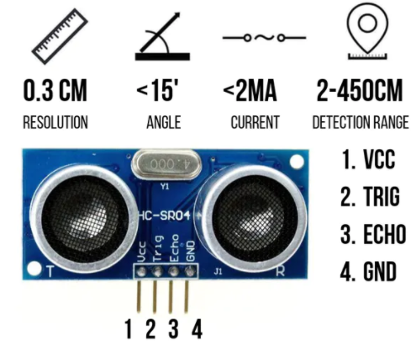
Ultrasonic Sensor HC-SR04 specifications and Configuration

Slide 4
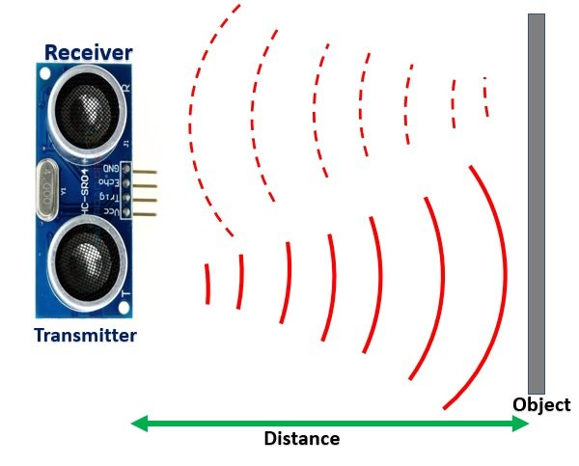
Working Principle of Ultrasonic Sensor.

Slide 5
Working principle cont…
To generate the ultrasound ,the Trigger Pin is set on a High State for 10 µs.
That will send out an 8 cycle sonic burst which will travel at the speed sound and it will be received in the Echo Pin.
The Echo Pin will output the time in microseconds the sound wave traveled.

Slide 6
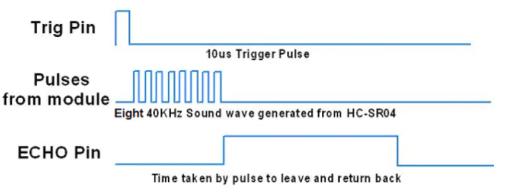
Ultrasonic module Timing Diagram

Slide 7
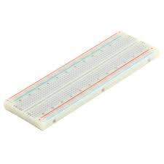
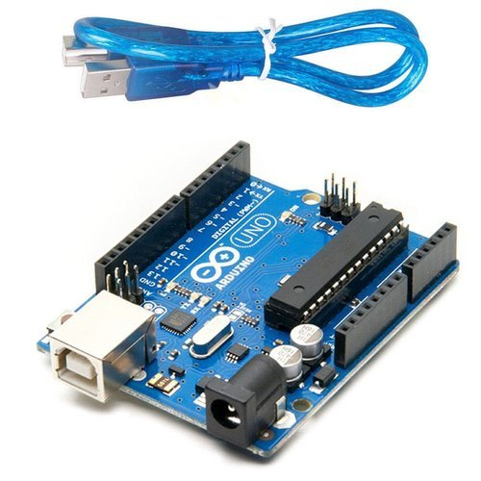
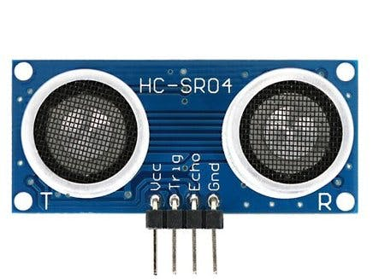
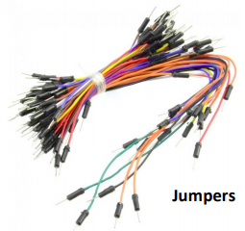
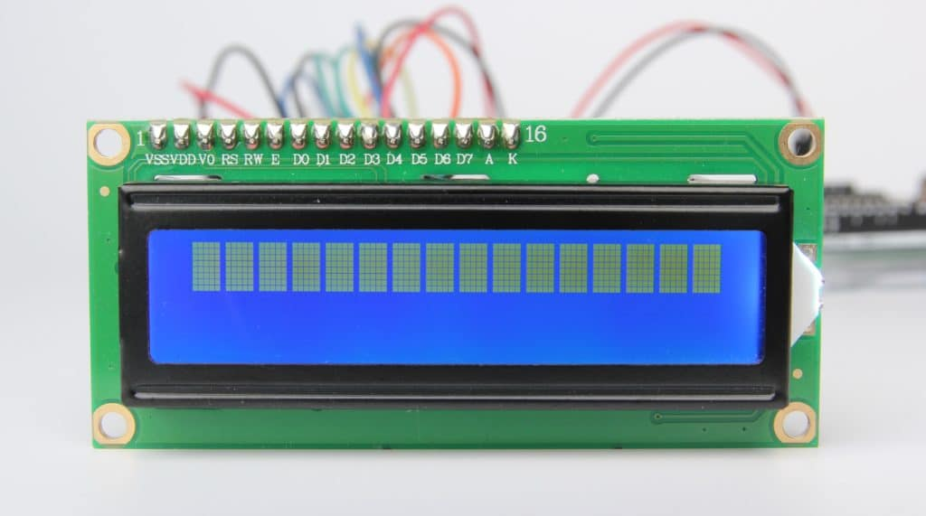
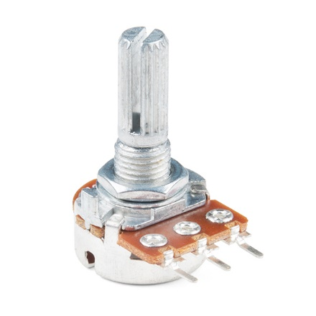
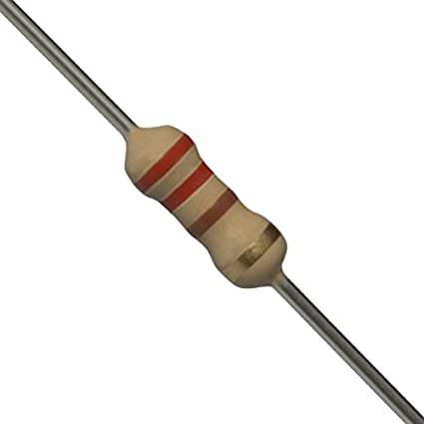
Components
Arduino UNO Ultrasonic Sensor HC-SR04 Breadboard
16x2 LCD Variable resistor(10kΩ) fixed resistor(220Ω)

Slide 8
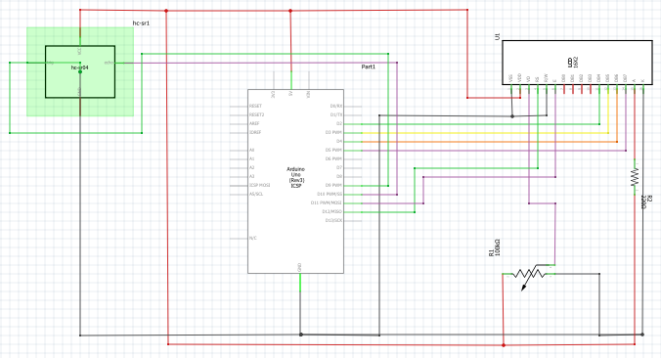
Schematic Circuit Diagram

Slide 9
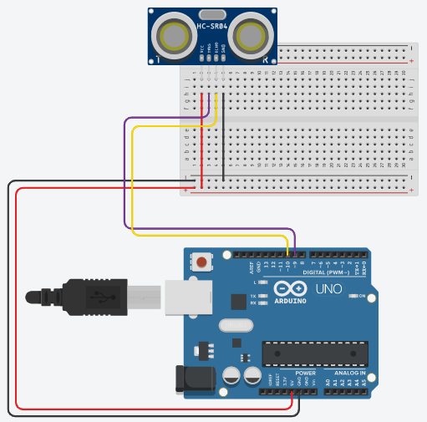
Bread board circuit without LCD screen

Slide 10
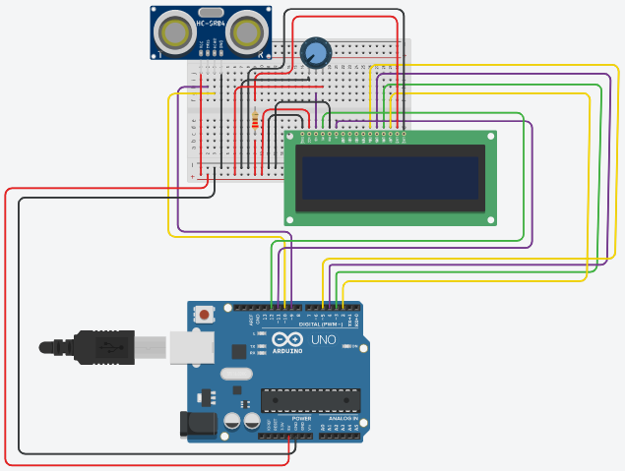
Breadboard circuit with LCD screen.

Slide 11


